Slide 1
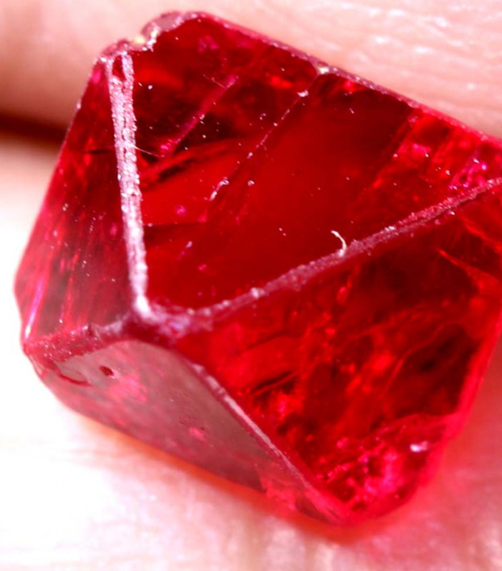
Spinel Presentation
By Tyler Kotsifas

Slide 2
Contents
Definition
Chemistry
Physical properties
Classification
Optical Properties
Fun Facts
General references

Slide 3
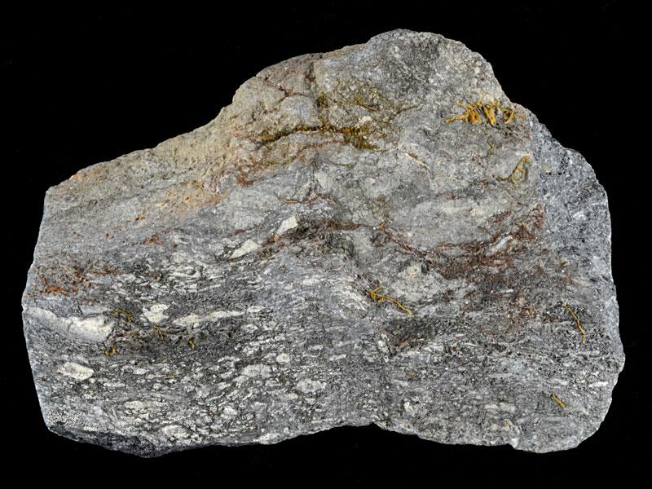
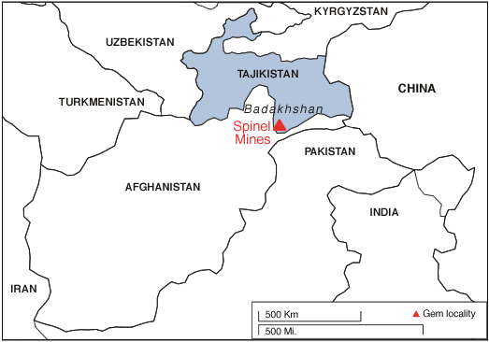
Basic Info
-Spinel is a metamorphic mineral, commonly found in metamorphosed limestones
-Also as a primary mineral in igneous rocks that are low in silica but rich in magnesium
-Gem quality spinel is often found in parts of Asia (Burma, Sri Lanka), and the Middle East
Notes:
Consider talking about:
Basic definition
Recent advances
Rocks, ores, and gems
Nomenclature and classification

Slide 4
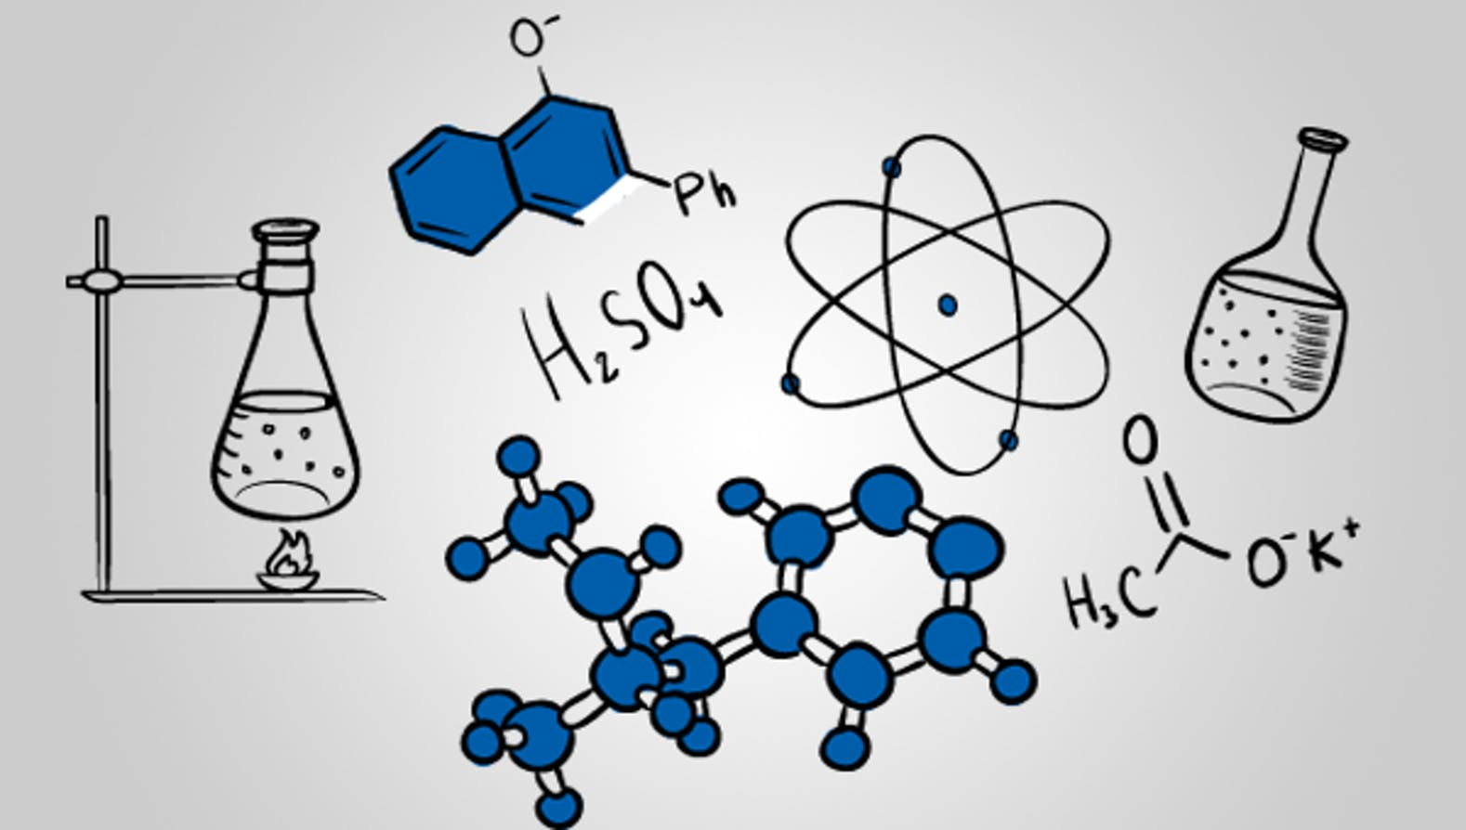
Chemistry
Chemical Formula: MgAl₂O₄
Spinel is the magnesium/aluminum end member of the larger spinel group
_{Spinel Group defined as:}
Crystallizes in Isometric System
Typically has Oxygen as an anion
Other minerals in this group are: Magnetite (Iron Spinel) and Gahnite

Slide 5
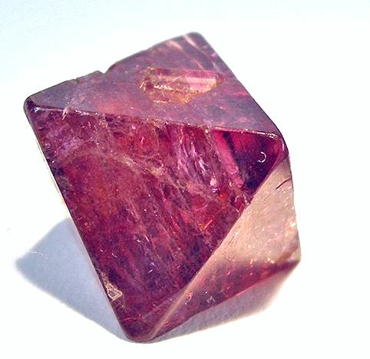
Physical Properties
-Variety of colors: blue, red, pink, green, black, violet
-Luster: Vitreous (like glass)
-Hardness Value of 7.5-8
-Specific Gravity between 3.6-4.1
-Has no good cleavage. Exhibits a conchoidal fracture
Notes:
Consider talking about:
Crystal structure and habit
Hardness
Lustre and diaphaneity
Colour and streak
Cleavage, parting, fracture, and tenacity
Specific gravity
Other properties

Slide 6
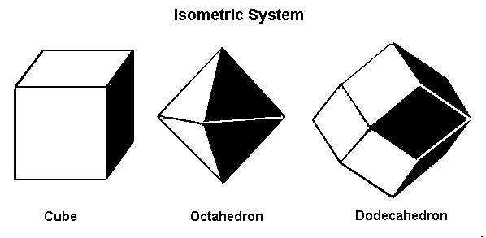
Classification
-Crystallizes in Isometric (Cubic) System, often Octahedral
-Miller Indices are variations of 111 face (looks like block #1)
Notes:
Consider talking about:
Silicates
Non-silicates

Slide 7
Optical Properties
Isotropic Mineral, behaves same in all directions
Refractive Index: n=1.719
Because it is isotropic, no birefringence or pleochroism

Slide 8
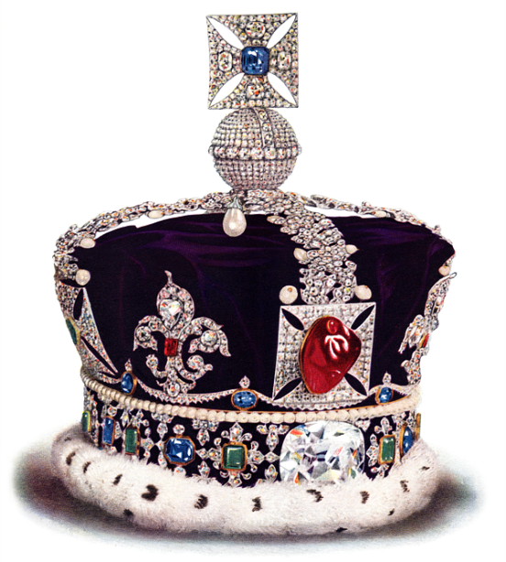
Fun Facts
For a long time red and blue spinels were always confused for rubies and sapphires
Forms under similar conditions and in the same rock units
Ruby and sapphire are made from corundum. Ancient gem traders didn’t know spinel and corundum are different
They thought every red gemstone was a ruby and every blue a sapphire
The Black Prince’s Ruby is a famous spinel misidentified as a ruby

Slide 9
Fun Facts (Continued)
Spinel is a gemstone that comes in a wide variety of colors
The most desirable color is a deep red but red spinel is actually rarer than ruby
Despite this spinel is not valued as much as a gemstone as ruby (cost is about 30% lower)
Gem quality spinel can be easily synthesized and made into any color in a lab

Slide 10
Works cited
Ralph, Chris. Spinel Mineral Information Photos and Facts, Gem Spinel, http://nevada-outback-gems.com/mineral_information/Spinel_mineral_info.htm.
“Spinel.” Geology, https://geology.com/minerals/spinel.shtml.
“Spinel.” Spinel: Mineral Information, Data and Localities., https://www.mindat.org/min-3729.html.
Spinel: The gemstone ruby Spinel information and pictures. (n.d.). Retrieved from https://www.minerals.net/gemstone/spinel_gemstone.aspx.

