Slide 1
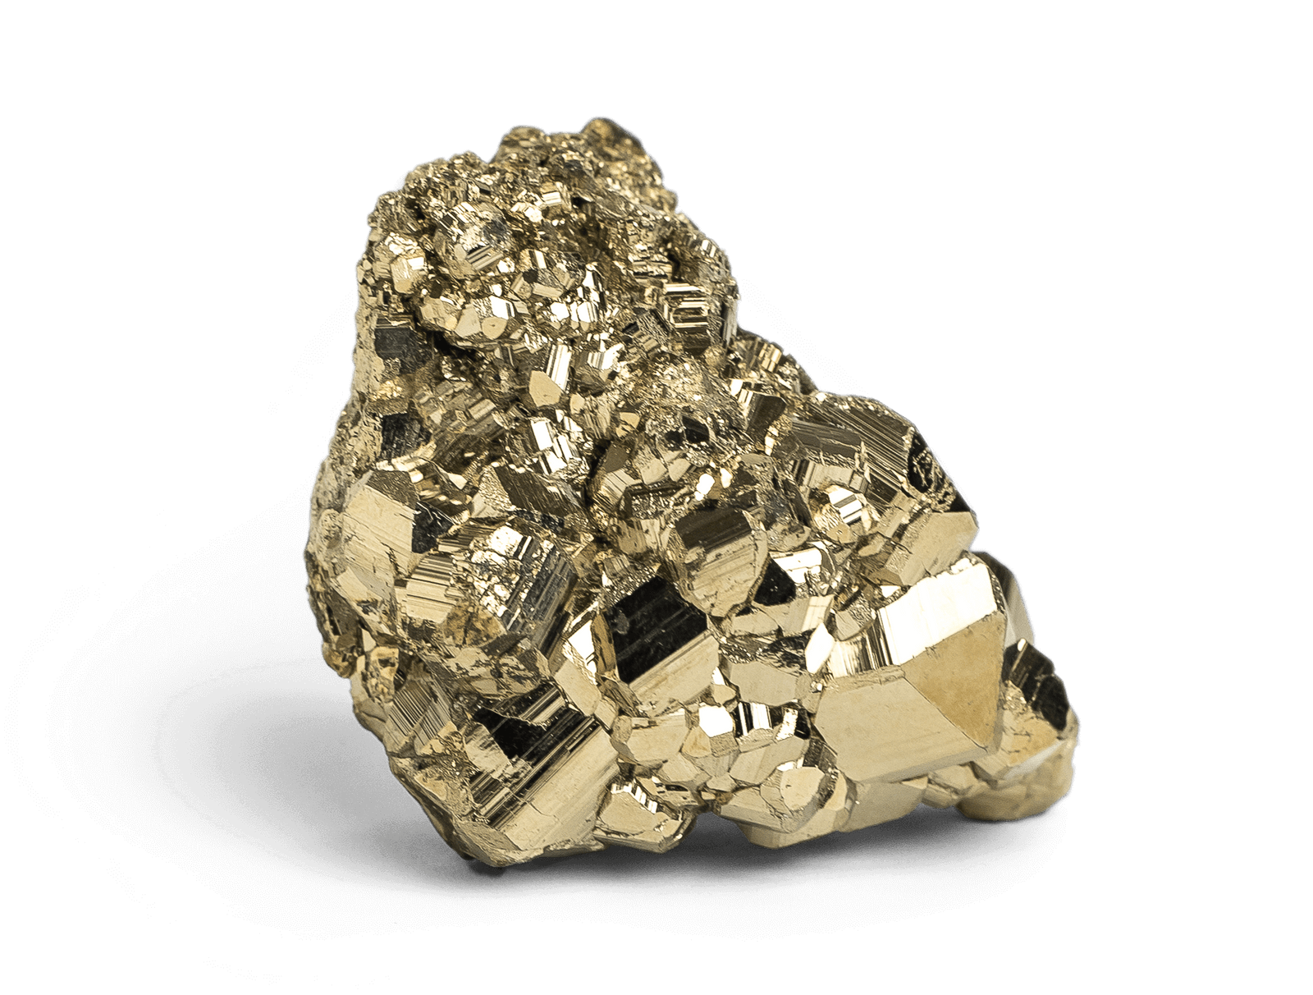
Pyrite
By Kerry McNally

Slide 2
General Info
Formula: FeS₂
Colour: Pale brass-yellow
Streak: Greenish-black
Lustre: Metallic
Hardness: 6 - 6½
Specific Gravity: 4.8 - 5
Crystal System: Isometric
Member of: Pyrite Group
Transparency: Opaque
Fracture: Irregular/Uneven, Conchoidala

Slide 3
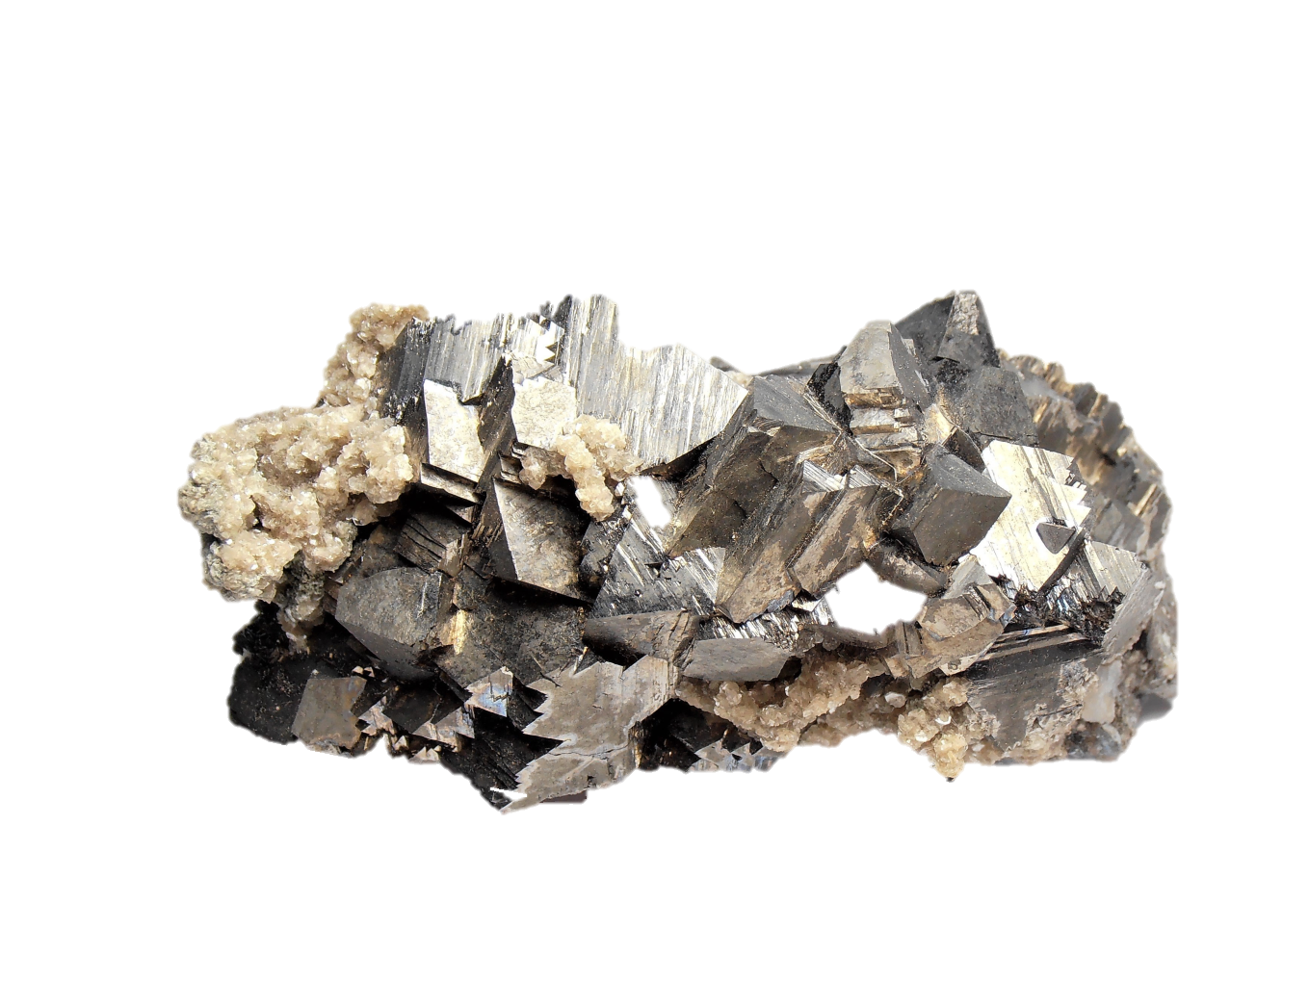
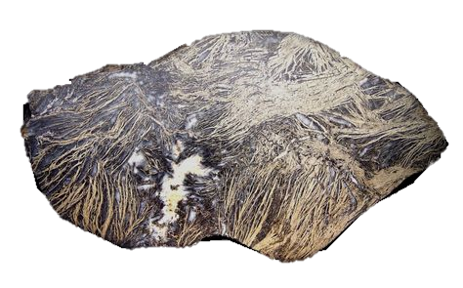
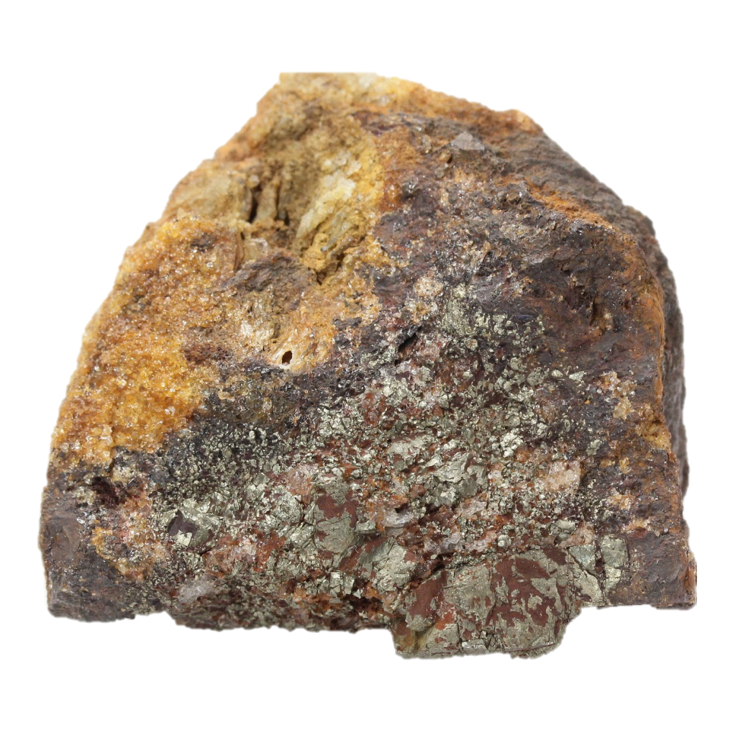
Auriferous Pyrite
Feather Pyrite
Arsenopyrite

Slide 4
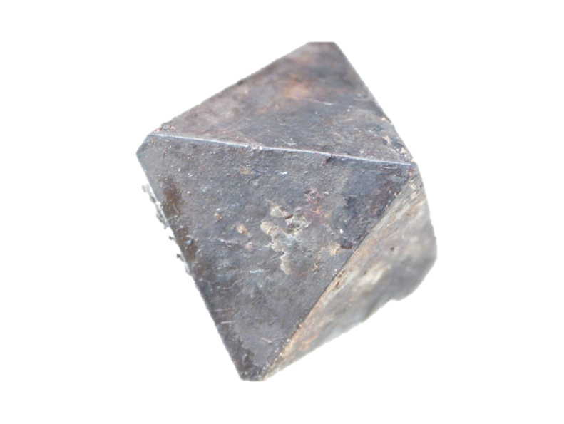
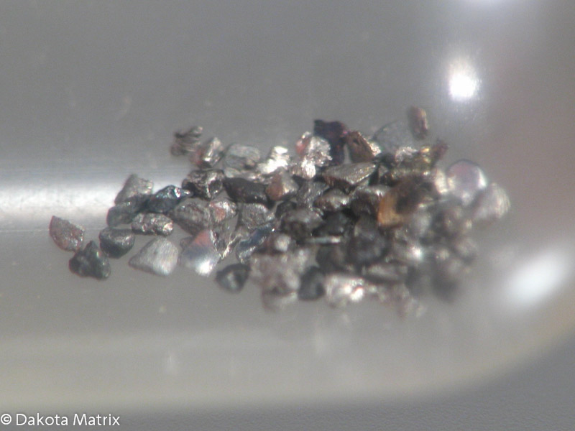
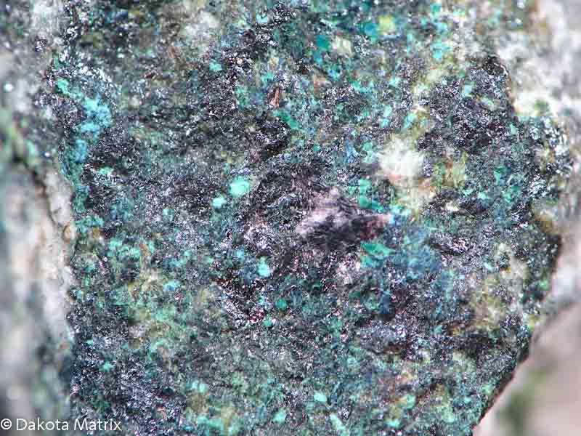
Pyrite Group
Aurostibite: AuSb2
Hauerite: MnS2
Laurite: RuS2
Villamaninite:
(Cu,Ni,Co,Fe)S2

Slide 5
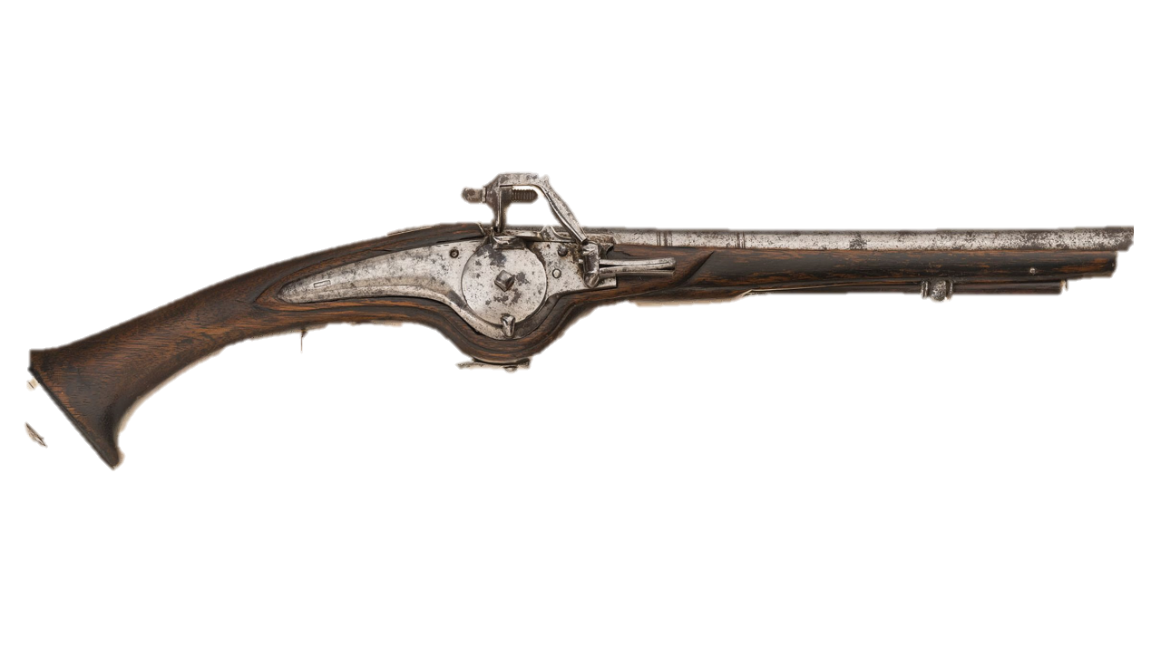
History of Pyrite
AKA: Fools Gold
Iron Disulfide
“Pyr” – Greek for fire
Was mistaken for gold, due to color
Was found in prehistoric burial grounds and was used to start fires.
Historically used in wheel-lock/flint lock guns

Slide 6
Where to Find Pyrite
Found under varied conditions
Accessory mineral in igneous rocks, often found with quartz and other sulfide minerals
In sedimentary rocks, often found in shale and limestone
Large deposits occur in metamorphic rocks such as schists or slates

Slide 7
Where to Find Pyrite Cont.

Slide 8
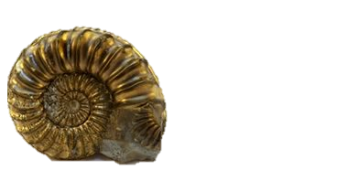
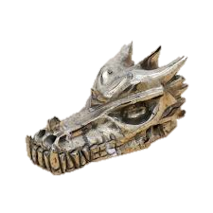
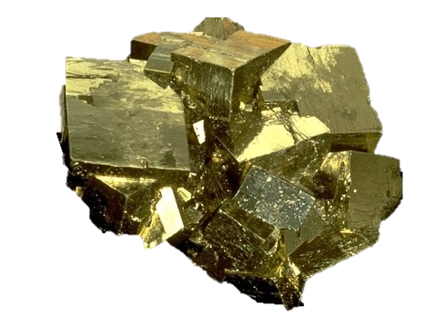
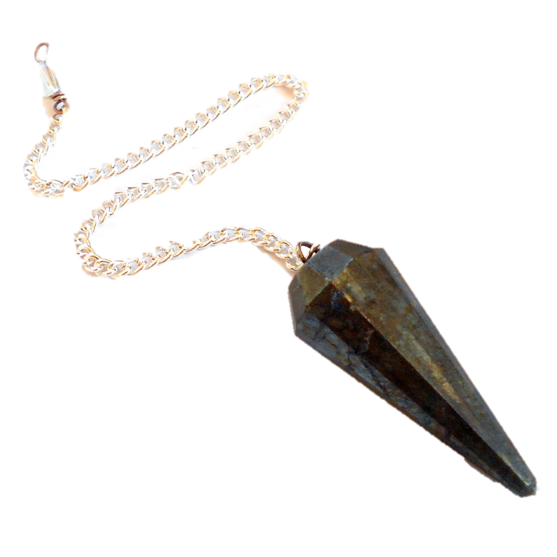
Uses of Pyrite
Originally used as source of sulfur
Now sulfur is obtained as a biproduct of oil and gas processing
Nowadays used as a gemstone
Beads, Cabochons
Can be used to get gold
Pyrite and gold can occur in the same rock

Slide 9
References
https://www.mindat.org/min-3314.html
https://www.britannica.com/science/pyrite
https://geology.com/minerals/pyrite.shtml

