Slide 1
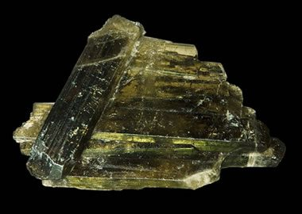
Epidote
Cassidy Yeh

Slide 2
Background/Rock relation
Rock forming mineral
Silicate mineral
Epidote mineral group has a crystal structure that consists of isolated and paired silica tetrahedron
Two main rocks: epidosite and unakite
High grade metamorphic rock; Amphibolite; Epidote amphibolite
Unakite forms from metamorphism of granite
Epidosite contains mostly epidote with bits of quartz; forms from basalts in sheeted dikes

Slide 3
Physical Properties
Color can be Yellowish-green, green, brownish-green, or black
Luster is vitreous
The hardness of this mineral is 6 on Mohs hardness scale
It is transparent, translucent, and opaque

Slide 4
Physical Properties cont.
Streak is colorless
Cleavage is Perfect; Perfect on {001}; imperfect on {100}
Fracture is uneven/irregular
Density is measured at 3.38-3.49 g/cm^3; Calculated is at 3.43 g/cm^3
Luminescence: non-flourescent

Slide 5
Chemical Properties
Formula is {Ca₂}{Al₂Fe³⁺}(Si₂O₇)(SiO₄)O(OH)
Elements in Epidote: Ca, Al, Fe, H, Si
Common impurities found in Epidote are Al, Mg, and Mn

Slide 6
Crystallography
Crystal system: Monoclinic
Class: Prismatic
Twinning: on {100}.
Morphology: Crystals are prismatic to 35 cm; stubby; rarely tabular or pseudo-octahedral
They are fibrous, coarse to finely granular

Slide 7
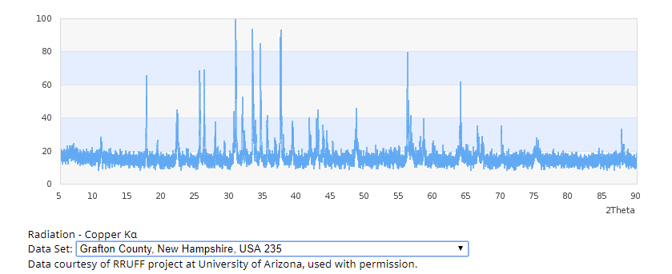
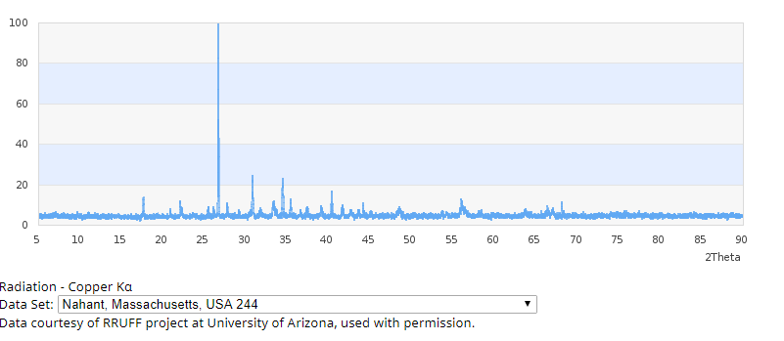
X-ray Diffraction

Slide 8
Optical Data of Epidote
Biaxial
X is colorless
Y is greenish yellow
Z is yellowish green
2V: 90 degrees to 116 degrees; 62 to 84 degrees

Slide 9
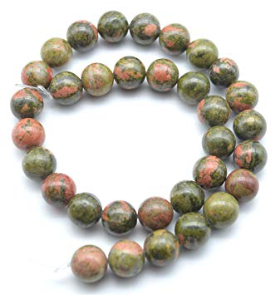
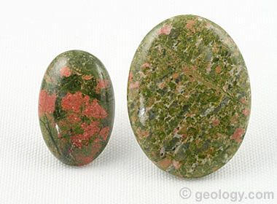
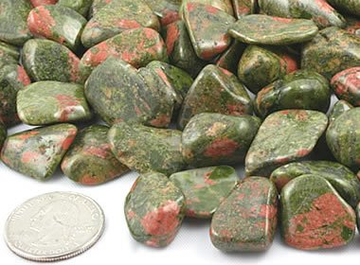
Epidote usage
Minor usage as a gemstone
Unakite: beads, ornamental objects; semiprecious stone; cabochons

Slide 10
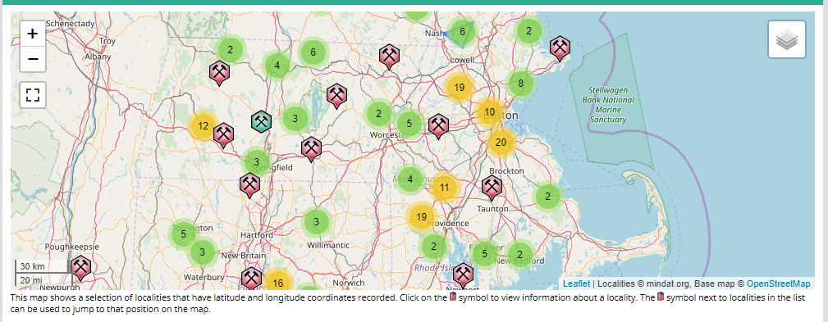
Locations of Epidote

Slide 11
References
“Epidote.” Epidote: Mineral Information, Data and Localities., www.mindat.org/min-1389.html.
“Epidote.” Geology, geology.com/minerals/epidote.shtml.

