Slide 3
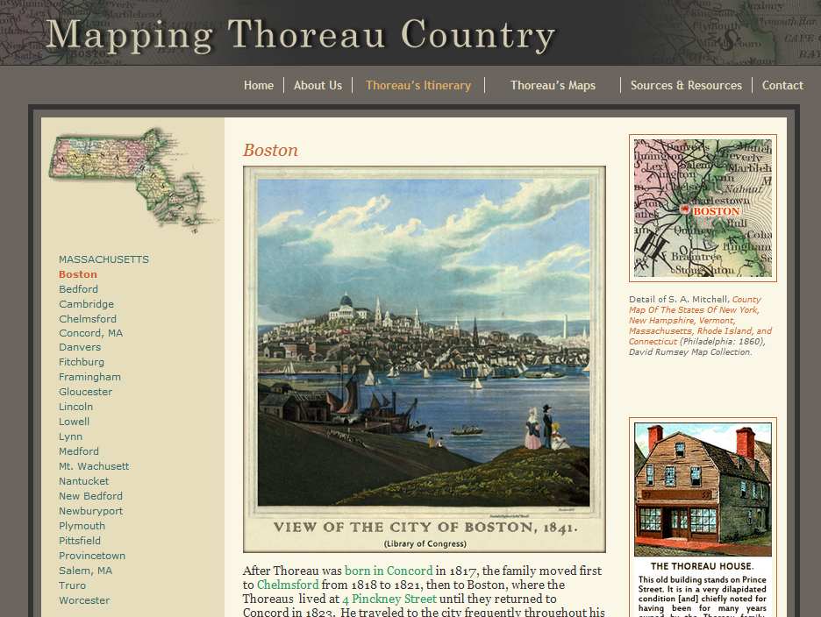

Slide 4
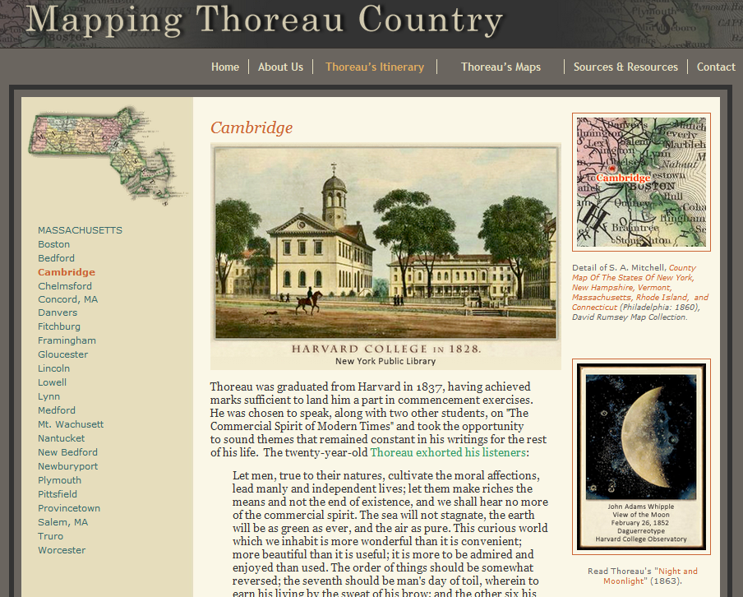

Slide 5
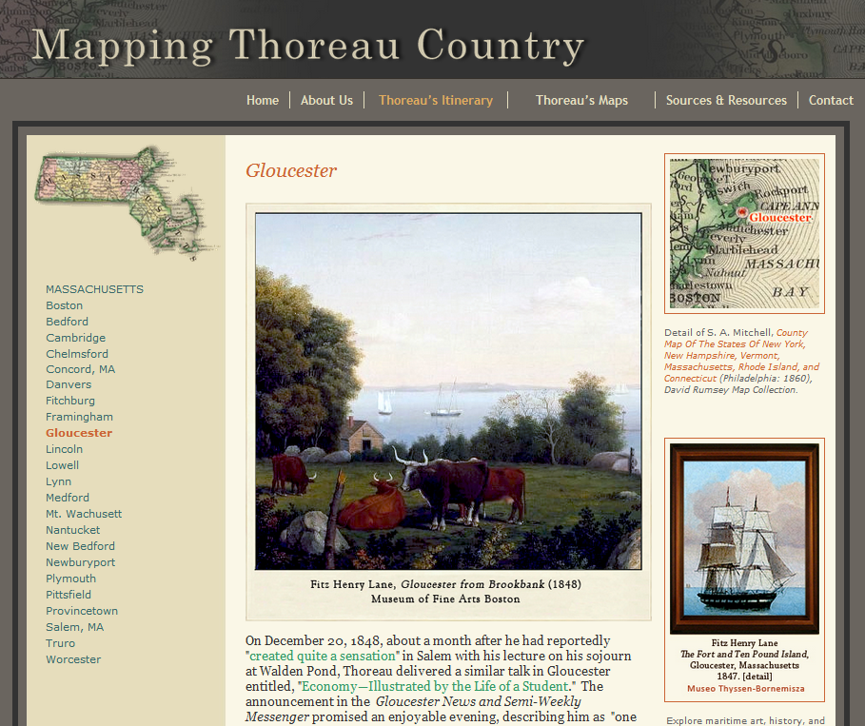

Slide 6
R.W. Emerson,
“Nature,” 1837.
C.P. Cranch, “Emerson’s Eyeball,” Scraps,1839.

Slide 7
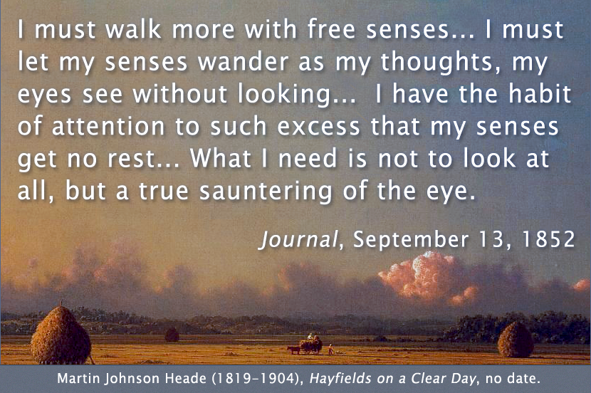

Slide 8
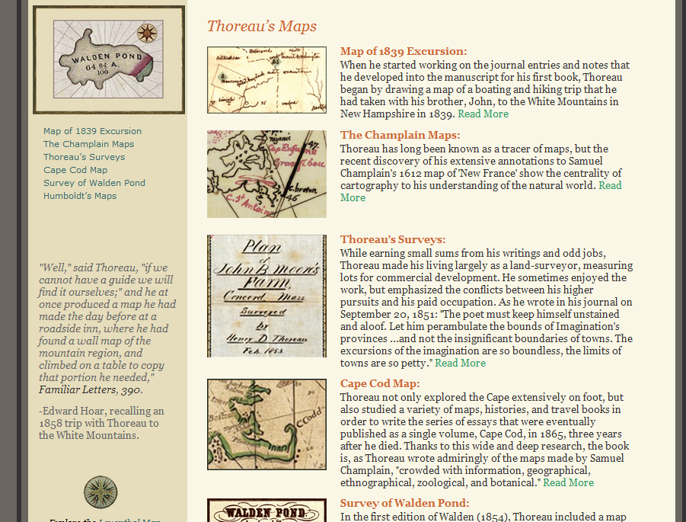

Slide 9
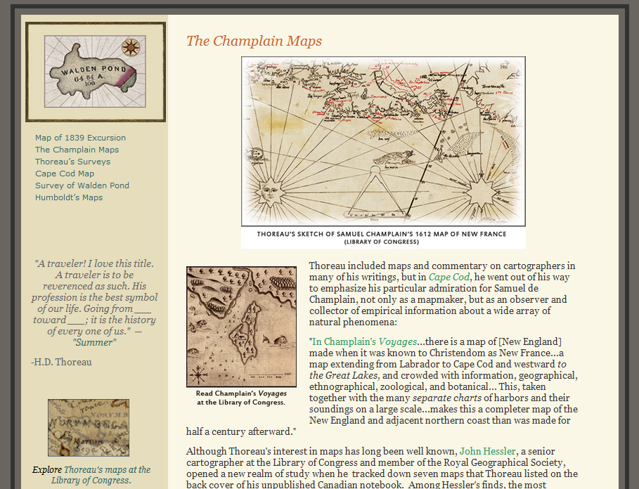

Slide 10
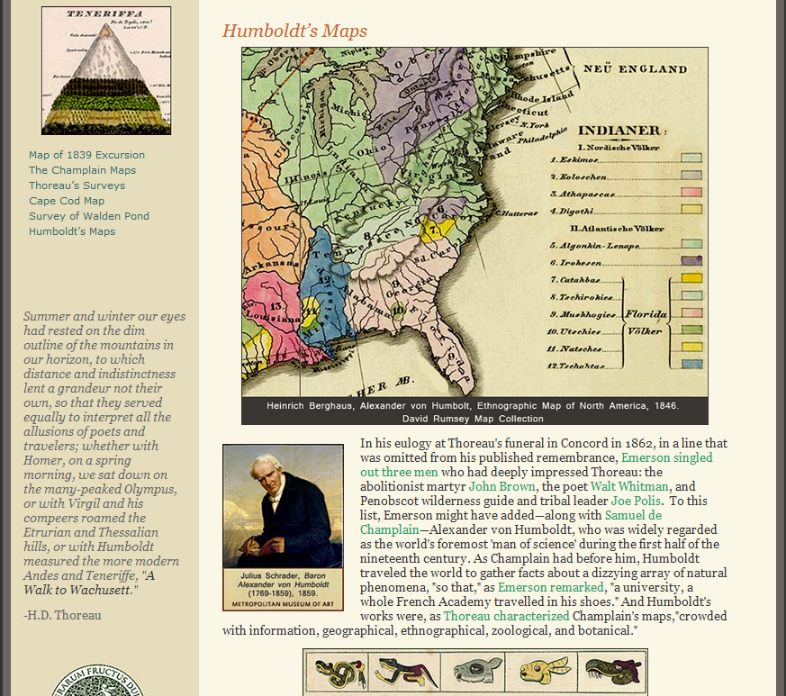

Slide 12
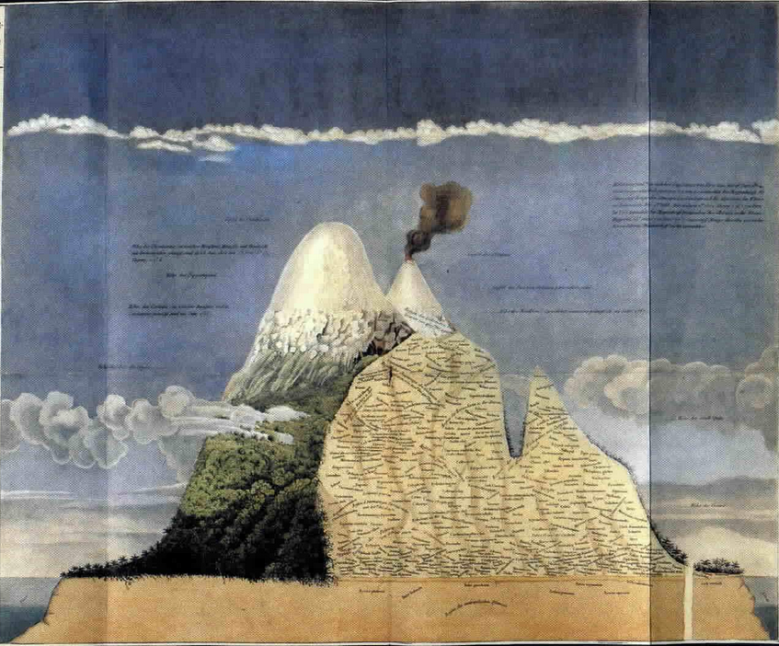
Notes:
Laura Dassow Walls: “Humboldt was perhaps most famous for his 1802 ascent of Ecuador’s Chimborazo, then thought to be the highest mountain in the world. Afterward, Humboldt developed his insight that vertical elevation correlated closely with global climate zones, from the equator to the poles: in climbing a single tropical mountain from base to alpine heights, he had in effect walked from the torrid equatorial tropics to frigid arctic ice. He portrayed his insight in a famous image of Chimborazo belted with the earth’s climate zones, an image that was copied for generations in popular geography texts and that captured the imagination of many in Thoreau’s day.”

Slide 13
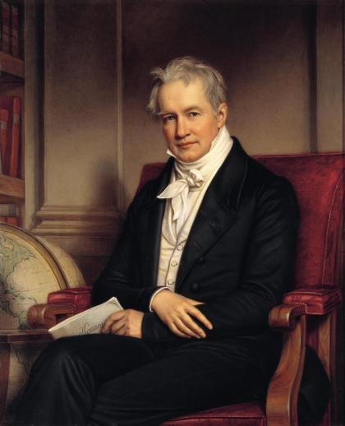
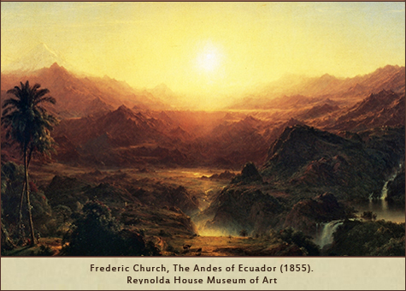
“Landscape painting must be a result at once of a deep and comprehensive reception of the visible spectacle of external nature, and of [an] inward process of the mind, “ Alexander von Humboldt, Cosmos (1847).
Notes:
Thoreau was too independent to play the role of disciple to anyone, but he had much in common with Humboldt's American devotees. He went out of his way to see the work of one of these followers, Hudson River School painter Frederic Church, whose Humboldtian landscape, The Andes of Ecuador, was displayed at the Boston Athenæum in 1855. Church produced the painting after traveling to South America in response to Humboldt's contention that landscape painting would attain new heights of expression if artistic imagination were melded with direct observation of the natural world. In the second volume of Cosmos: A Sketch of a Physical Description of the Universe (1847) , Humboldt urged artists to engage in scientific exploration, arguing that "landscape painting must be a result at once of a deep and comprehensive reception of the visible spectacle of external nature, and of [an] inward process of the mind."

Slide 14
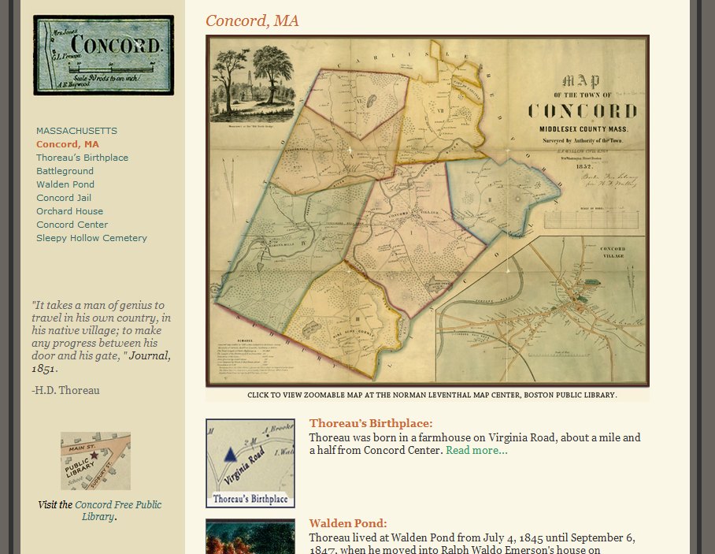
Notes:
“It takes a man of genius to travel in his own country, in his native village; to make any progress between his door and his gate,”
Journal, 1851.

Slide 15
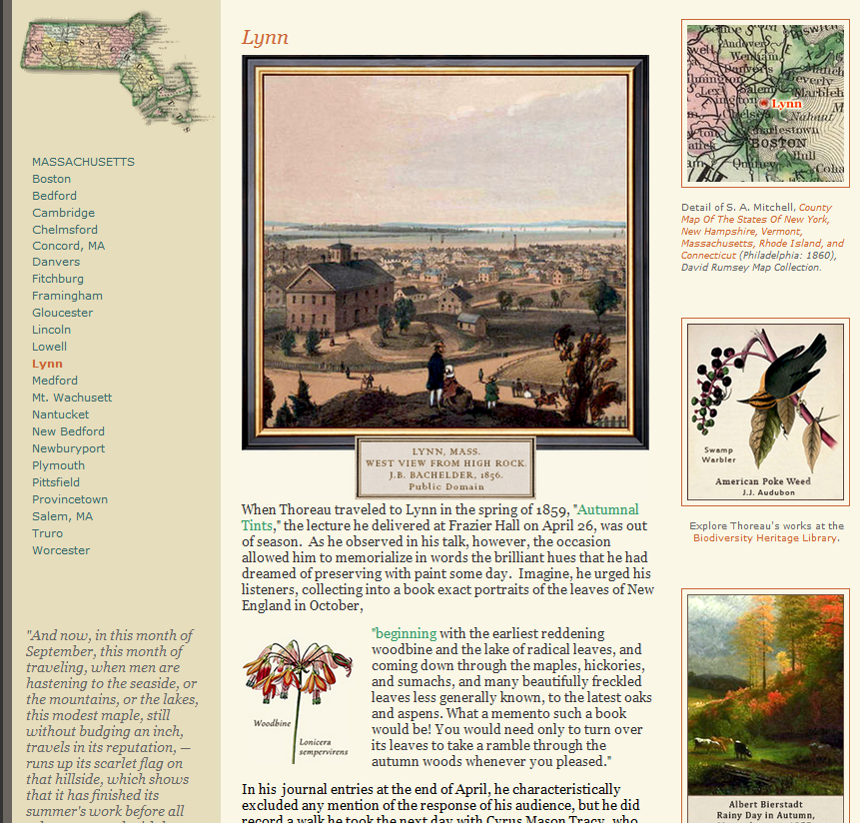

Slide 16
Albert Bierstadt, Rainy Day in Autumn, Massachusetts, 1857.

Slide 17
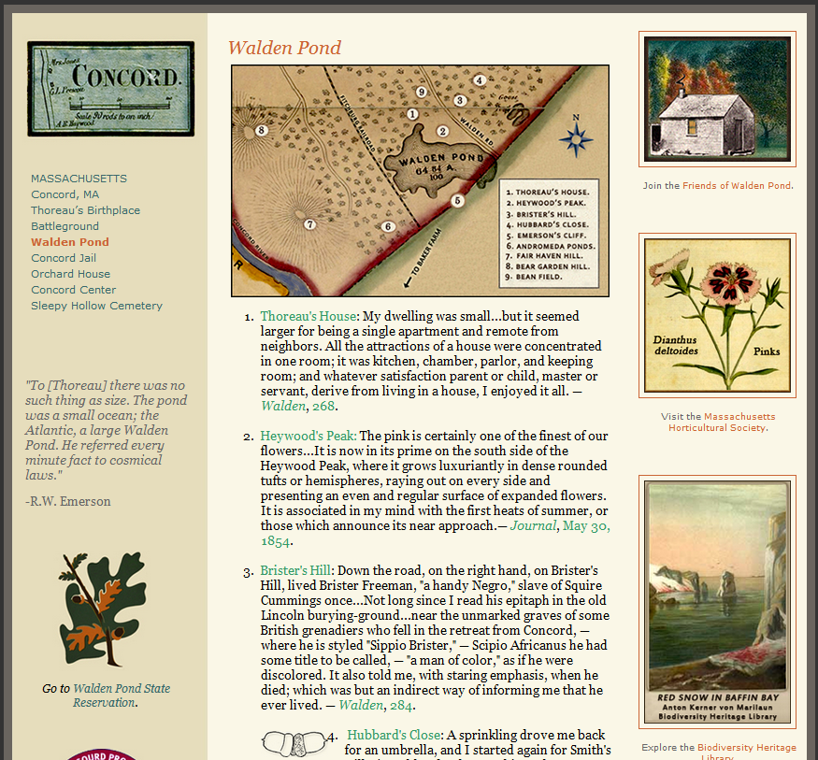

Slide 18
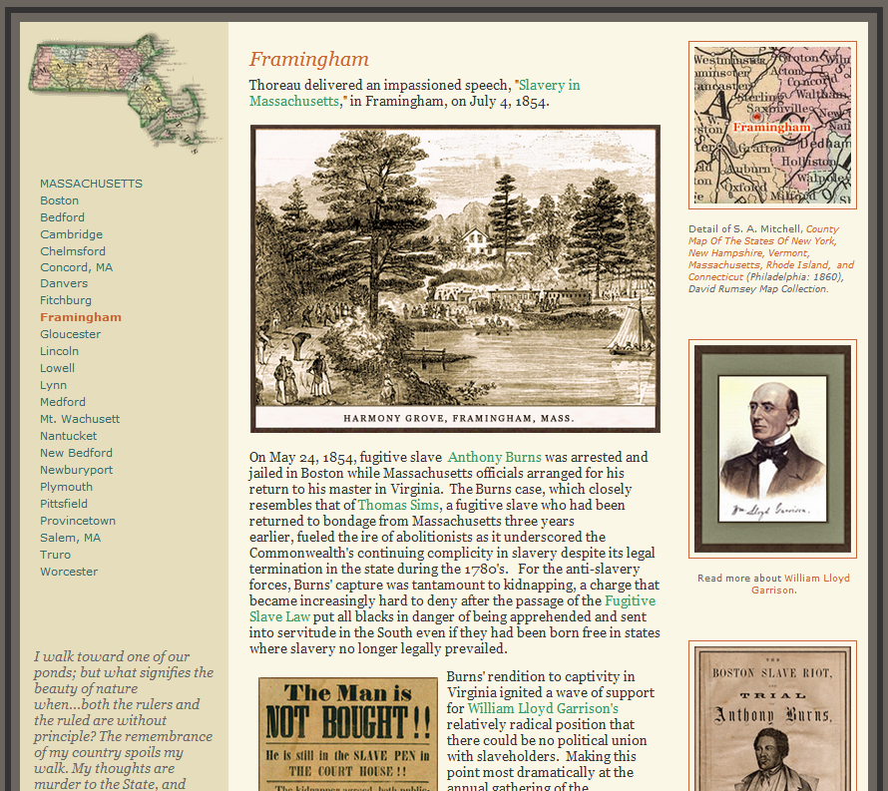

Slide 19
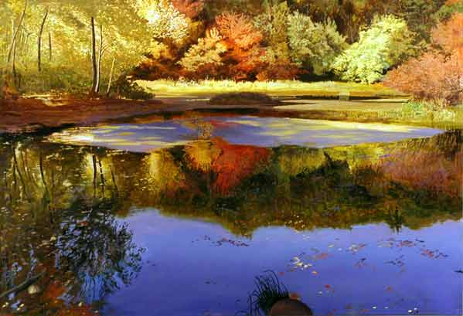
Arthur Chartow Walden Pond II
“Art is as long as ever, but life is more interrupted and less available for a man's proper pursuits. It is not an era of repose. We have used up all our inherited freedom. If we would save our lives, we must fight for them,”
“Slavery in Massachusetts,” 1854.
Notes:
I walk toward one of our ponds; but what signifies the beauty of nature when men are base? We walk to lakes to see our serenity reflected in them; when we are not serene, we go not to them. Who can be serene in a country where both the rulers and the ruled are without principle? The remembrance of my country spoils my walk. My thoughts are murder to the State, and involuntarily go plotting against her.

Slide 20
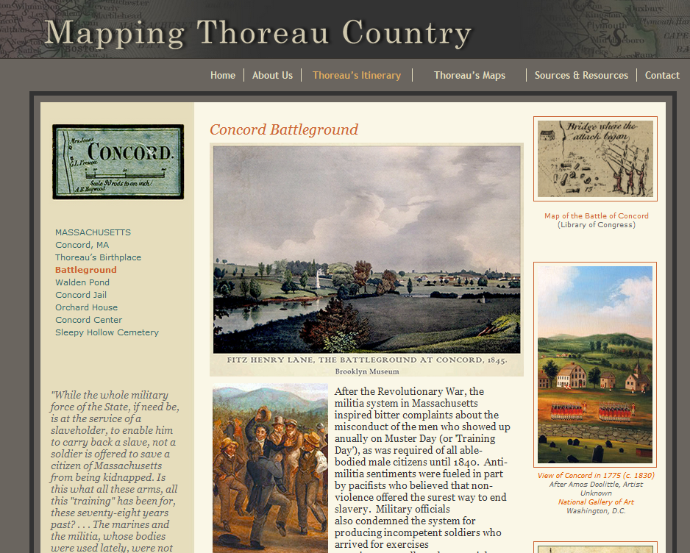

Slide 21
