Slide 1
16.312
Electronics II Lab. Experiment I
Two Weeks

Slide 2
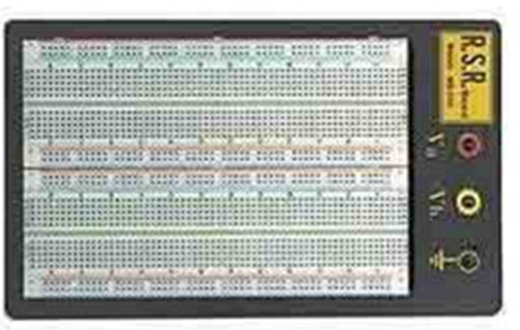
Solderless Prototyping Board jacks for power connections

Slide 3
Experiment 1 and 2
Design Three Op-Amp circuits and test and evaluate them
Design will come out of National Semiconductor’s Application Notes AN-31
One circuit from each section
Section 1 - Basic Circuits
Section 2 - Signal Generation
Section 3 – Signal Processing

Slide 4
Supplied Components
1 ea. AD-712 IC, 8 pin DIP
Resistors ( free stock )
Capacitors ( free stock )

Slide 5
Electrical Characteristics
Vcc = +15 volts DC - 15 volts DC
Voltage linearity to be checked and recorded
Frequency to be checked and recorded
Record Supply Current required
Circuit Function to be checked and recorded

Slide 6
Notebooks
Everything should be in your notebook
Parts list with component cost
Schematics / block diagrams/component layouts
Data tables data points every .5 volts
Test layout diagram,
Result conclusions,
Scope print-outs to back-up data & conclu.
In ink !!!!!

Slide 7
Grading (2 weeks; Total is 20% of the final grade)
Prep. (before 1st lab session): 30%
  Title; objectives of the experiment; date;
  Schematics of the 3 chosen circuits (10%)
  Circuit assembly layout drawing (15%)
  Parts list (name, model, company, prices) (5%)
Circuit description (how it works, in notebook) 10%
Neat circuit layout on board 15%
Data tables in notebook 10%
Scope pictures (in notebook) 15%
Bench test (Q & A) with the TA 10%
Clean up the lab space 10%

